Slide 1
Public Key Cryptography & RSA

Slide 2
Private-Key Cryptography
Traditional private/secret/single key
Cryptography uses one key
Shared by both sender and receiver
If this key is disclosed, communications are compromised
Also is symmetric, parties are equal
Hence does not protect sender from receiver forging a message & claiming is sent by sender

Slide 3
Public-Key Cryptography
Probably most significant advance in the 3000 year history of cryptography
Uses two keys – a public & a private key
Anyone knowing the public key can encrypt messages or verify signatures
But cannot decrypt messages or create signatures
Asymmetric since parties are not equal
Complements rather than replaces private key crypto

Slide 4
Public-Key Cryptography
Public-key/two-key/asymmetric cryptography involves the use of two keys:
A public-key, which may be known by anybody, and can be used to encrypt messages, and verify signatures
A private-key, known only to the recipient, used to
Decrypt messages, and sign (create) signatures
Is asymmetric because
Those who encrypt messages or verify signatures
Cannot decrypt messages or create signatures

Slide 5
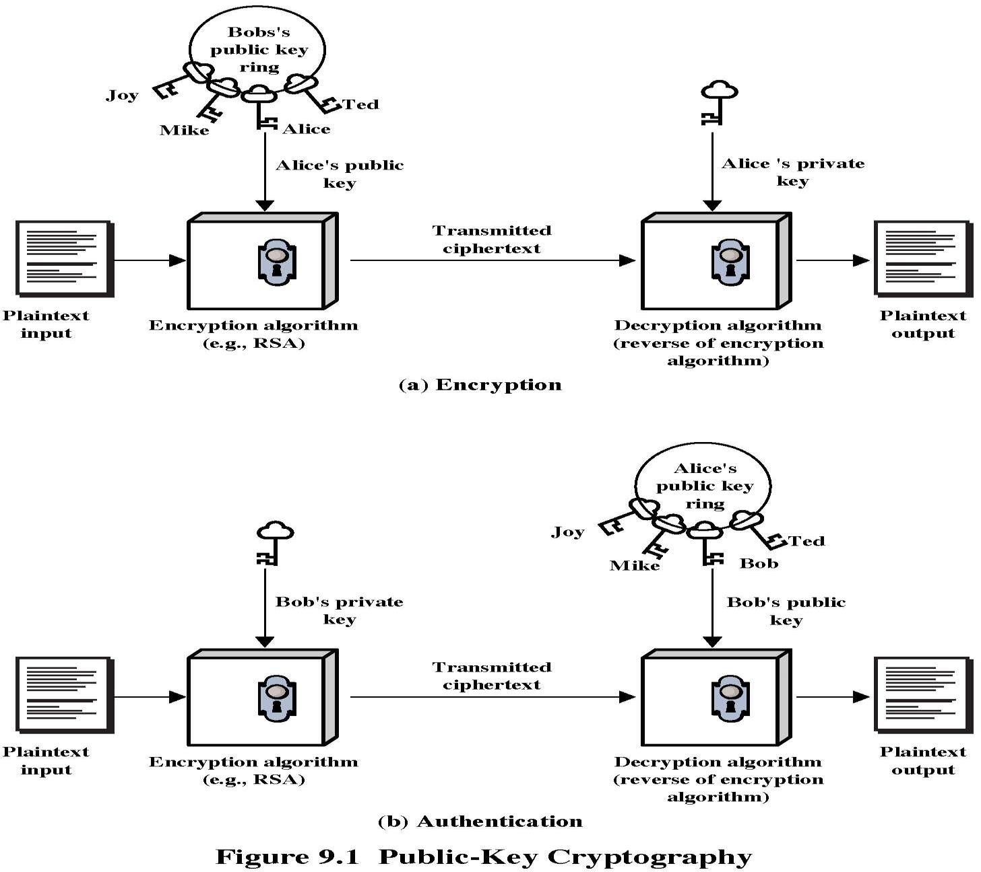

Slide 6
Why Public-Key Cryptography?
Developed to address two key issues:
Key distribution – how to have secure communications in general without having to trust a KDC with your key
No need for secure key delivery
No one else needs to know your private key
Digital signatures – how to verify a message comes intact from the claimed sender

Slide 7
Public-Key Characteristics
Public-key algorithms rely on two keys with the characteristics that it is:
Computationally infeasible to find decryption key knowing only algorithm & encryption key
Computationally easy to en/decrypt messages when the relevant (en/decrypt) key is known
Oneway-ness is desirable: exp/log, mul/fac
Either of the two related keys can be used for encryption, with the other used for decryption (in some schemes)

Slide 8
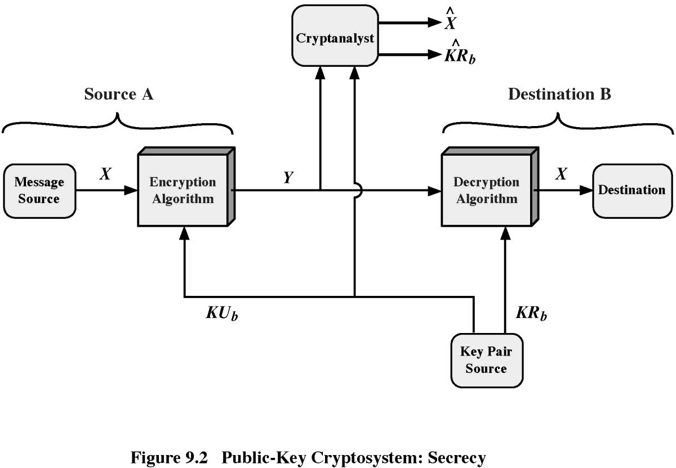
Public-Key Cryptosystems: Secrecy

Slide 9
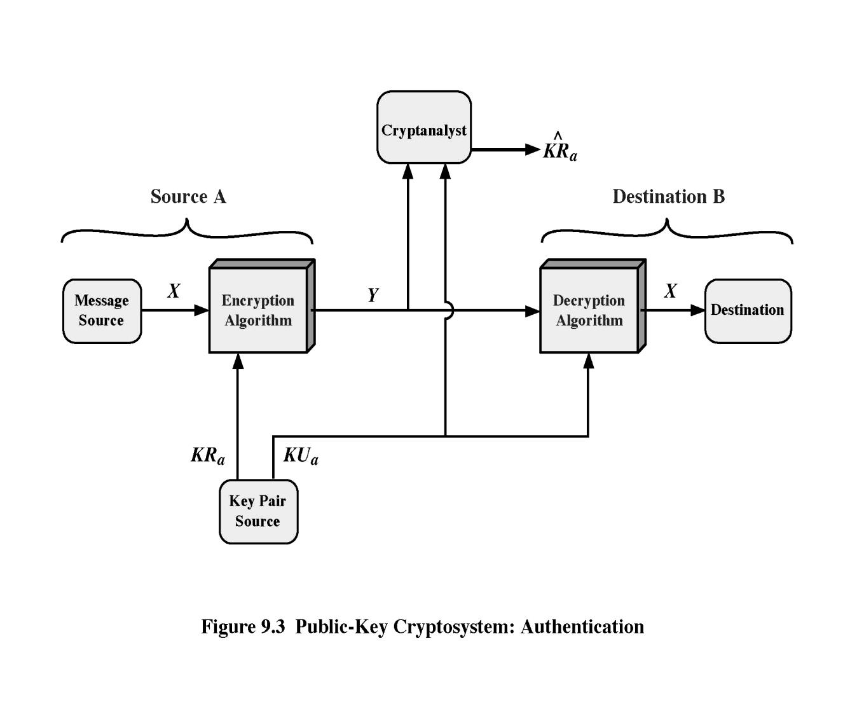
Public-Key Cryptosystems: Authentication

Slide 10
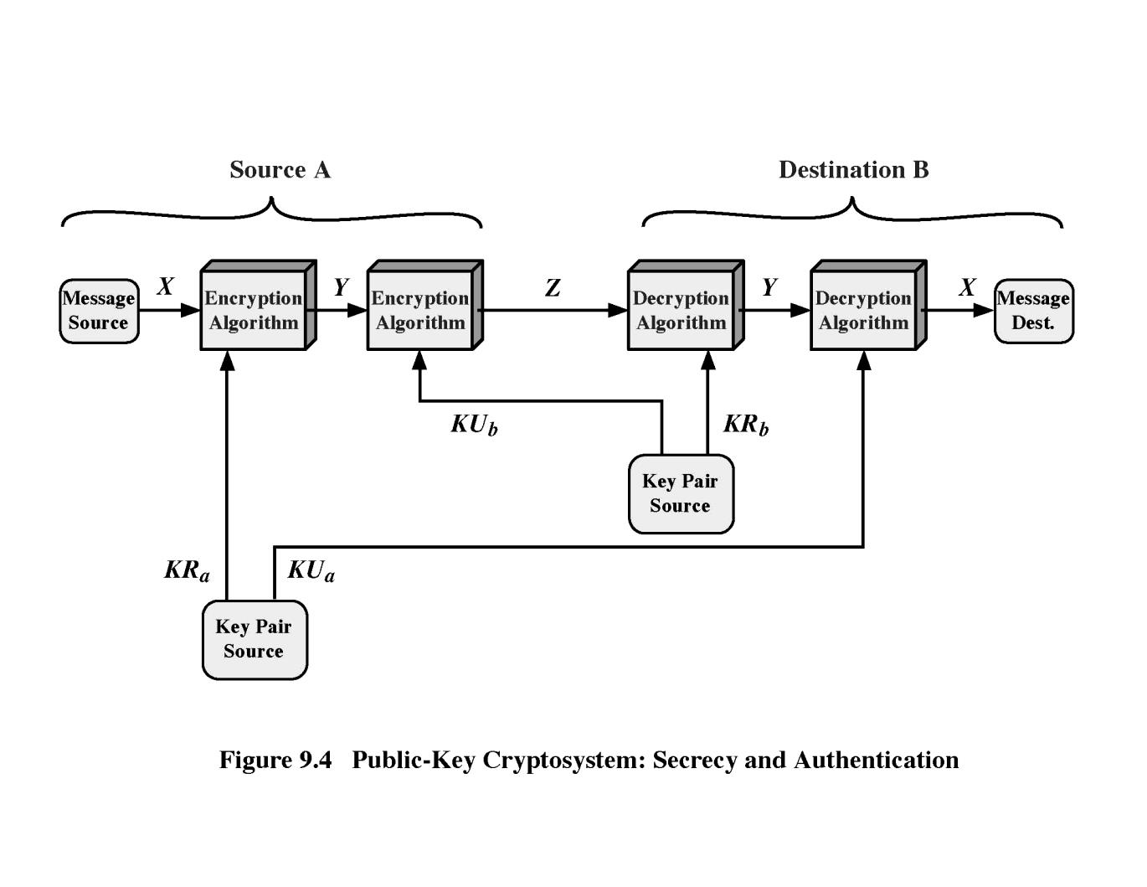
Public-Key Cryptosystems: Secrecy and Authentication

Slide 11
Public-Key Applications
Can classify uses into 3 categories:
Encryption/decryption (provide secrecy)
Digital signatures (provide authentication)
Key exchange (session keys)
Some algorithms are suitable for all uses, others are specific to one

Slide 12
Security of Public Key Schemes
Like private key schemes brute force exhaustive search attack is always theoretically possible
But keys used are too large (>512bits)
Security relies on a large enough difference in difficulty between easy (en/decrypt) and hard (cryptanalyse) problems
Requires the use of very large numbers
Hence is slow compared to private key schemes

Slide 13
RSA
By Rivest, Shamir & Adleman of MIT in 1977
Best known & widely used public-key scheme
Based on exponentiation of integers in a finite (Galois) field
Defined over integers modulo a prime
Exponentiation takes o((log n)³) operations (easy)
Uses large integers (eg. 1024 bits)
Security due to cost of factoring large numbers
Factorization takes o(e ^{log n log log n}) operations (hard)

Slide 14
RSA Key Setup
Each user generates a public/private key pair by:
Selecting two large primes at random - p,q (secret)
Computing their system modulus n=p.q (public)
Note ø(n)=(p-1)(q-1) (secret)
Selecting at random the encryption key e (public)
Where 1<e<ø(n), gcd(e,ø(n))=1
Solve following equation to find decryption key d (secret)
e.d = 1mod ø(n) and 0≤d≤n
Use the extended euclid’s algorithm to find the multiplicative inverse of e (mod ø(n))
Publish their public encryption key: ku={e,n}
Keep secret private decryption key: kr={d,p,q}

Slide 15
RSA Example
Select primes: p=17 & q=11
Compute n = pq =17×11=187
Compute ø(n)=(p–1)(q-1)=16×10=160
Select e : gcd(e,160)=1; choose e=7
Determine d: de=1 mod 160 and d < 160
Value is d=23 since 23×7=161= 10×160+1
Publish public key KU={7,187}
Keep secret private key KR={23,17,11}

Slide 16
RSA Example cont
Sample RSA encryption/decryption is:
Given message M = HI =89
Encryption:
C = 89⁷ mod 187 = 166
Decryption:
M = 166²³
mod 187 = 89

Slide 17
Use of RSA
To encrypt a message M the sender:
Obtains public key of recipient ku={e,n}
Computes: c=m^{e}modn, where 0≤m<n
To decrypt the cipher text C the owner:
Uses their private key kr={d,p,q}
Computes: m=c^{d}modn
Note that the message M must be smaller than the modulus n (block if needed)

Slide 18
Block size of RSA
Each block is represented as an integer number
Each block has a value M less than N
The block size is <= log₂(N) bits
If the block size is k bits then 2^{k} <= N <= 2^{K+1}

Slide 19
Why RSA Works
Because of Euler's Theorem:
a^{ø(n)}modn = 1 where gcd(a,n)=1
RSA have:
n=p.q
ø(n)=(p-1)(q-1)
carefully chosen e & d to be inverses mod ø(n)
hence e.d=1+k.ø(n) for some k
Two cases arise:
1. gcd(m,n) = 1
2. gcd(m,n) > 1

Slide 20
Exponentiation
Can use the square and multiply algorithm
A fast, efficient algorithm for exponentiation
Concept is based on repeatedly squaring base
And multiplying in the ones that are needed to compute the result

Slide 21
RSA Key Generation
Users of RSA must:
Determine two primes at random - p, q
Select either e or d and compute the other
Primes p,q must not be easily derived from modulus n=p.q
Means must be sufficiently large
Typically guess and use probabilistic test
Exponents e, d are inverses, so use inverse algorithm to compute the other

Slide 22
RSA Security
Three approaches to attacking RSA:
Brute force key search (infeasible given size of numbers)
Mathematical attacks (based on difficulty of computing ø(n), by factoring modulus N)
Timing attacks (on running of decryption)

Slide 23
Factoring Problem
mathematical approach takes 3 forms:
factor N=p.q, hence find ø(N) and then d
determine ø(N) directly and find d
find d directly
currently believe all equivalent to factoring
have seen slow improvements over the years
as of Aug-99 best is 130 decimal digits (512) bit with GNFS
biggest improvement comes from improved algorithm
cf “Quadratic Sieve” to “Generalized Number Field Sieve”
barring dramatic breakthrough 1024+ bit RSA secure
ensure p, q of similar size and matching other constraints

Slide 24
Timing Attacks
developed in mid-1990’s
exploit timing variations in operations
infer bits of d based on time taken
countermeasures
use constant exponentiation time
add random delays
blind values used in calculations
C’ = (Mr)^{e}, M’ = (C’)^{d}, M=M’r⁻¹

Slide 25
Demonstrate the RSA Encryption and Decryption using p=3, q=11& e= 7 of a message M = 2

Slide 26
Summary
have considered:
principles of public-key cryptography
RSA algorithm, implementation, security

